Slide 1



THINKING AND ANALYSIS (cont.)

Slide 2

Chapter outlines
THINKING AND ANALYSIS
Creative Thinking Skills (cont.)
Thinking with Technology
Notes:
Pattern /ˈpæt̬.ɚn/:

Slide 3

LEARNING OBJECTIVES
By the end of this section, you will be able to:
Describe the role of creative thinking skills in problem-solving
Identify technology tools that enhance our learning
Explain how technology skills relate to critical/creative thinking skills
Examine online learning in the context of organizing, communicating, reading, and researching online
Assess our readiness to use technology

Slide 4

Creative problem-solving is a type of problem-solving. It involves searching for new and novel solutions to problems.
Unlike critical thinking, which scrutinizes assumptions and uses reasoning, creative thinking is about generating alternative ideas - practices and solutions that are unique and effective.
It’s about facing sometimes muddy and unclear problems and seeing how “things” can be done differently - how new solutions can be imagined.
Problem-Solving with Creative Thinking
Notes:
Ok, bàn xong về một số pp kích thích tư duy sáng tạo của con người. Giờ cta tiếp tục bàn đến vấn đề áp dụng creative thinking để giải quyết vấn đề
Giải quyết vấn đề một cách sáng tạo LÀ một phương án giải quyết vấn đề, đúng ko ạ? Nó bao gồm việc cta phải đi tìm kiếm những giải pháp mới và tối ưu cho vấn đề. Creative ở đây là việc cta đưa ra được các phương án thay thế khác nhau, để cùng đánh giá đc mức độ hiệu quả và khả thi của từng phương án
Ví dụ activity: How to draw a circle? (viết càng nhiều cách càng tốt, người sau ko đc trùng vs người trước)

Slide 5
Activity
Brainstorming
Project start up "Social initiative":
Discuss in small groups, propose a creative social initiative, to solve any problem our society.

Slide 6

Notes:
Defer = delay / postpone
Nói qua

Slide 7
Brainstorming technique
Start
Ideas generation
Ideas combination
Evaluation & Validation
Generate new ideas
Selection of best ideas
End
Notes:
Link web có thể tham khảo về creative techniques: https://www.mycoted.com/Category:Creativity_Techniques

Slide 8
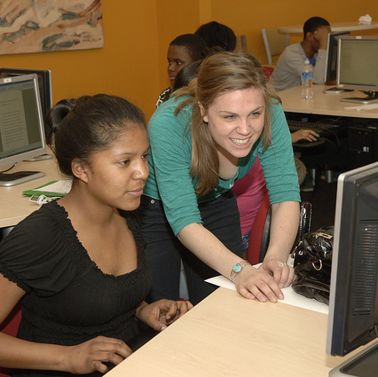
3. Thinking with Technology
Notes:
YC tự đọc phần này, làm 1 câu hỏi trên edunext

Slide 9

Benefit of information technology
It empowers people to do what they want to do.
It lets people be creative. It lets people be productive.
It lets people learn things they didn’t think they could learn before.
And so in a sense it is all about potential.

Slide 10

Technology for College Learning
85% of college-bound students say technology in the classroom and the availability of online classes are their top determinants in choosing a college.
"Digital Capabilities at Universities Key to Draw Students." CareerIndia. 28 Nov 2014. Web. 16 Feb 2016.

Slide 11
Discussion
Did technology influence your college decisions?

Slide 12
Critical & Creative Thinking with Technology
Computer software and Internet resources allow students to record, defend, and challenge their thinking.
Digital camcorders allow students to observe and analyze the world - to resee and reimagine it in a way that appeals to them.

Slide 13
Critical & Creative Thinking with Technology
Interactive whiteboards are helpful for class discussions about ideas or Web content; they facilitate whole-class display and hands-on participation.
Student-response systems, like clickers, allow students to respond to questions and then debate the answers.

Slide 14
Critical & Creative Thinking with Technology
Blogs can serve as personal journals, where students can record, share, and reflect on field experiences and research activities. Students can also use blogs as a preestablished environment for critically responding to assigned readings.
Wikis can help students coordinate, compile, synthesize, and present individual or group projects or research, as well as build and share group resources and knowledge. Wikis can also help students provide peer review, feedback, and critiques.
Discussion boards can help students establish a sense of community with their class and engage in ongoing threaded conversations on assigned readings and topics highlighting diverse points of view.

Slide 15
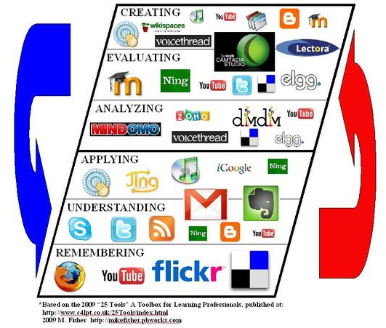
How different digital technologies can help faculty and students with critical and creative thinking?
Notes:
The red and blue arrows outside the diagram indicate the fluidity with which the tools can travel through the different levels in the taxonomy.

Slide 16
It is specially designed to help California’s online community college students. (for references)
Getting Tech-Ready:
https://apps.3cmediasolutions.org/oei/modules/tech/
Introduction to Online Learning:
https://apps.3cmediasolutions.org/oei/modules/intro/
Organizing with Technology
https://apps.3cmediasolutions.org/oei/modules/organizing/
Communicating with Technology:
https://apps.3cmediasolutions.org/oei/modules/communication/
Reading and Researching with Technology:
https://apps.3cmediasolutions.org/oei/modules/reading/

Slide 17
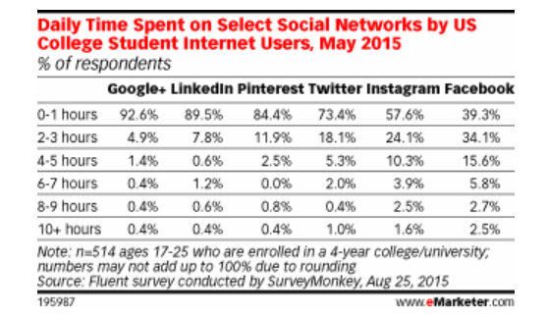
Mobile Learning and Social Networking
Mobile Learning: By the time the class of 2016 graduates, close to 91.4 percent of U.S. college students will own a smartphone (17 million).
Social Networking: See the eMarketer.com data graph showing the daily time spent on select social networks by U.S. college student Internet users, as of May 2015. Social networking can readily facilitate learning.

Slide 18


